Slide 1
Electrical Safety Project WP6 Annual Review 2024
Lukasz Pater
2024-11-15
Indico 1416608

Slide 2
WP6 - Overview
6.1 Documentation WPL: Denis Ribiollet (as of 03.2025)
Establish workflows, roles, and responsibilities for the creation and maintenance of documents pertinent for the electrical safety
6.2 Databases & Electrical Safety Portal WPL: Lukasz Pater
Assess databases for electrical data, collaborate on a unified portal specification, and develop the portal.
WP 6.3 Electrical Knowledge Dissemination WPL: ESP Core team
Implement processes and procedures to secure the distribution of electrical knowledge and standards in the ATS sector.
Notes:
Let’s start with a quick recap
Setup framework for managnig esp documentation
WP6 aims at providing a technical backbone that other packages can rely on

Slide 3
Roadmap Recap (Q4 2023 - 2024​)
WP6.2
Request for
one graduate
WP6.2
Data Analysis
WP5.2
Specification
Equipment Explorer
SLD Viewer
FP Attributes
WP6.2 Arrival of two
graduates
Q4
Q1
Q2
Q3
Q4
WP4.2 Portal Data Rqmt WP4.3 Lockout Data Rqmt
WP6.2
Data
Identification
Second
graduate
approved
ESP Portal v0.1
Core Framework
Equipment Explorer
Knowledge Base
Notes:
Even with a few empty chairs in the team, we still got a ton done! Now, let's take a look.
Data Analysis, for example for the files automatic or semi automatic import
During the summer summer:
5.2, thanks to Kamil
FP attributes, for equipment that is on the frontiers of EN-EL responsbility, how we store it, and provide most convienet for the users to manipulate it
Arrival two grads:

Slide 4
Data Identification and Analysis
The initially identified systems relevant to ESP appear to be largely comprehensive and are expected to serve as the project’s foundation
Additional applications and databases were reviewed, but most, such as ElecCalc—a software used for electrical calculations—were deemed outside the project’s scope.
NORMA DB has been transferred to EN-IM and is currently undergoing a rewrite, with minimal likelihood of directly impacting ESP.
We are also in discussions with the IMPACT team to explore how it might contribute to ESP
Sailor (Elec)
Alim DB
Gesmar (Cabloteque)
EAM (MTF)
Layout DB
SCADA
SCADA
NXCALS
GIS
SCADA
Excel Files
Drawings
Notes:
This graph is something what was result if preliminary discussions with member in my workpackage
What we didn’t manage to investiagate NORMA back then

Slide 5
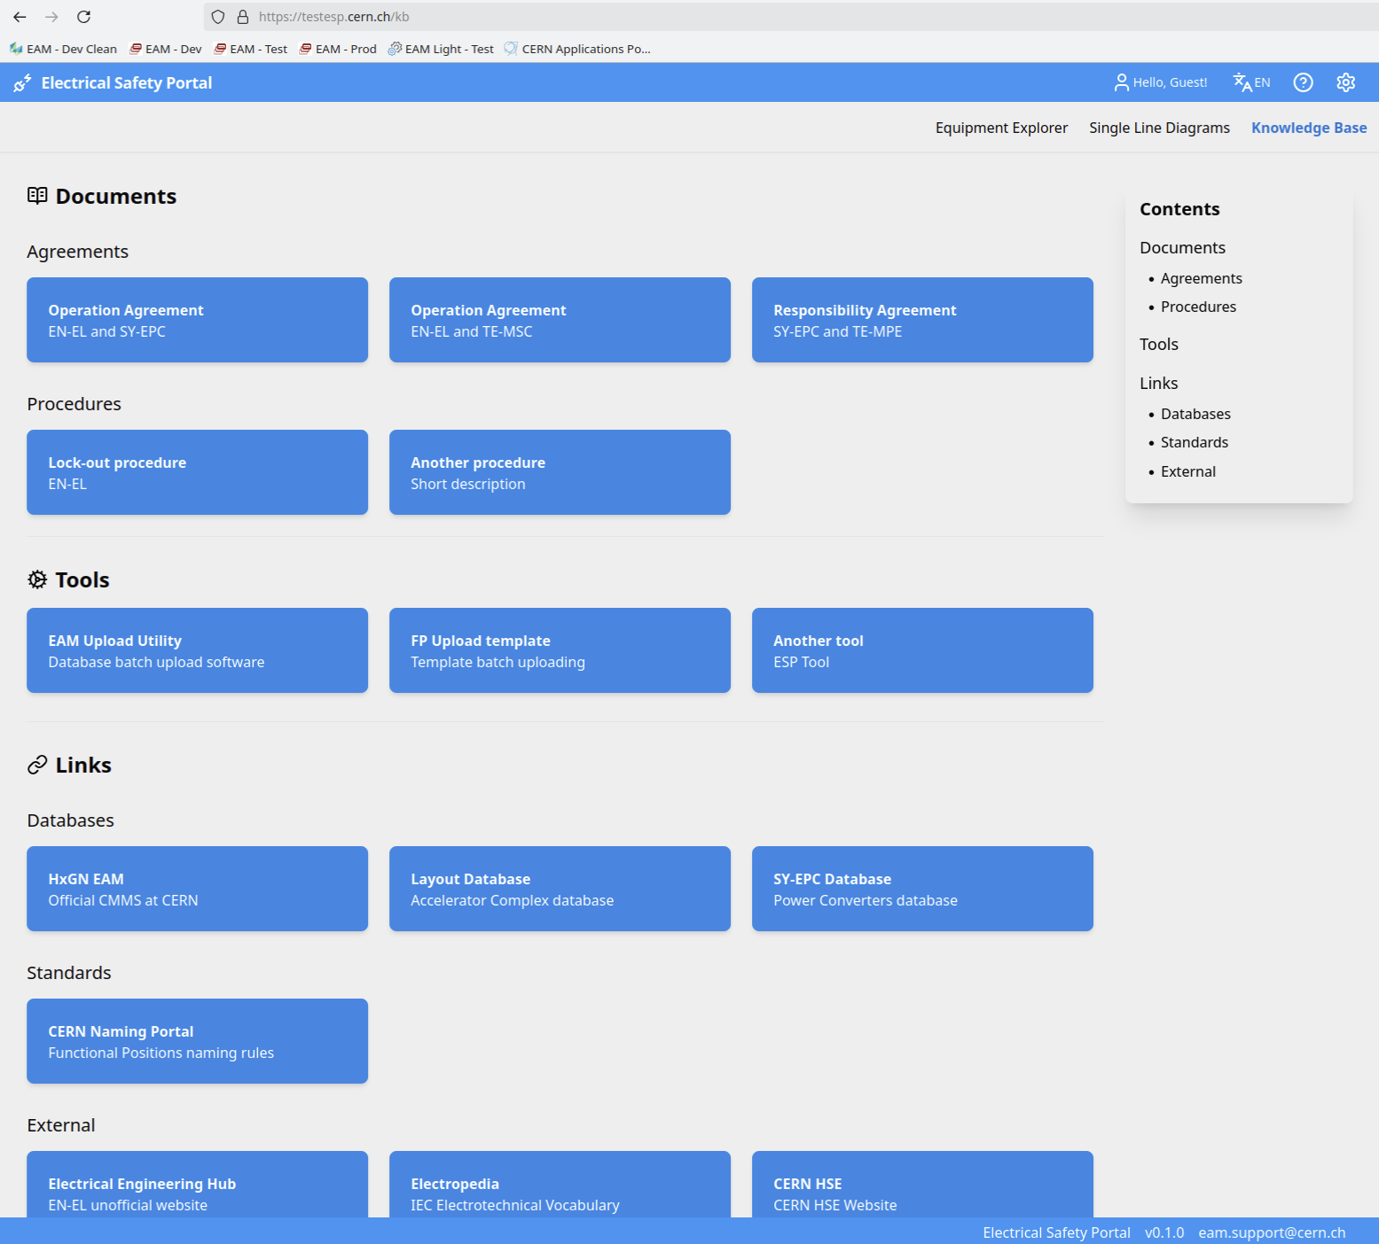
Electrical Safety Portal v0.1 – Equipment Explorer
Notes:
You might understandably think that calling this an “Electrical Safety Portal” feels a bit premature, as we’re still a long way from a complete solution.
However, I believe it’s essential to strive for a single portal that can meet most of the project’s needs, and enforcing this from day 0 really makes sense, so the FP Explorer justifies its eaarly existence.
The functionality will keep expanding and the tool may look and behave differently depending on who’s using it, yet it should remain a unified tool—even if it’s built on multiple databases. Doesn’t matter what your role in ESP ist -> esp.cern.ch
Now, let’s bring Kamil’s mockup to life and walk through the implementation together and explore the core of the tool

Slide 6
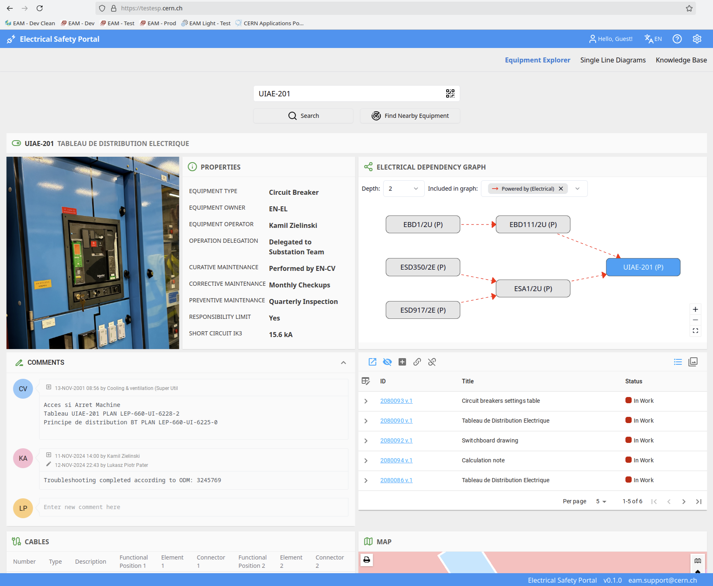
Electrical Safety Portal v0.1
Built on EAM, Gesmar, Layout, GIS (Alim, Sailor) to maximize reuse of existing systems.
Developed using the EN-IM tech-stack, ensuring rapid development and familiarity for most software developers within the group.
Infrastructure established with three environments across three dedicated availability zones.
Responsive design optimized for mobile usability.
Notes:
GRoups for APPlications Authorization

Slide 7
Electrical Safety Portal v0.1
Real-time updates, enabling instant reflection of edits.
Intuitive, geolocation-driven interface that dynamically adjusts content visibility based on user role, location, and contextual relevance.
Single Sign-On (+ guest mode) and e-groups/GRAPPA integrated.
Role-based access control fully supported.
Multilingual support.
Caching mechanism implemented for optimized performance and to maintain functionality in case of underlying system failures.
Notes:
GRoups for APPlications Authorization
HTTP/2 with Server Push, Server-Sent Events

Slide 8
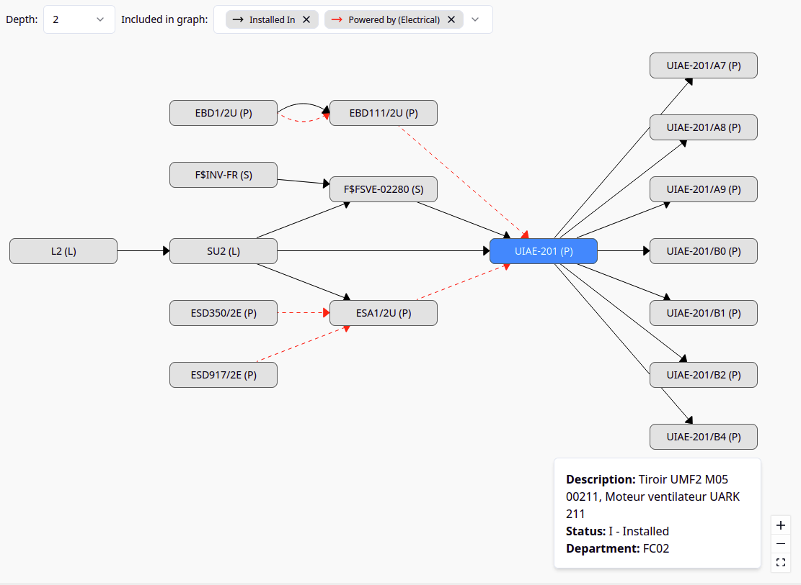
Equiment Graph
The Equipment Graph was developed to display various relationships between equipment in EAM.
Recently, it was completely rewritten to align with the technology stack currently in use within the group, keeping ESP requirements in focus.
This new version enables full flexibility in terms of rendering options, animations, and declarative configuration of behavior.
Numerous discussions with EN-EL helped shape and finalize the requirements.
Notes:
What we knew from the start,

Slide 9
Roadmap 2025
WP6.2
Submit
Documentation for
Engineering check
ESP Portal v0.2
SLD Viewer
First use case identified during the pilot
Open to key users
WP6.1
Document
Collection
Q1
Q2
Q3
Q4
WP6.1
Document
Definition
ESP Portal v0.3
Production rollout
More pilot use-cases
Lockout MVP
WP4.3
Lockout
Data Rqmt and
Functional Spec
WP4.2
Portal
Data Rqmt and
Functional Spec

Slide 10
Conclusions
The two graduates, Iulian and Afonso, joined us two weeks ago and are steadily familiarizing themselves with the technologies and the domain.
The project pilot urgently needs to explore real-world use cases, which will also aid in identifying data quality issues.
As of Q1 2025 we will work in sprint cycles, actively engaging relevant stakeholders to shape the tool's development.
Complete the document outlining the various systems relevant to the project, then submit it for an engineering review (Q1 2025)
Share the specification with the IMPACT team and begin work on the lockouts (Q2 2025)
Graduates are an invaluable foundation for our team, but in the future, dedicated staff will be essential to manage growing complexity and provide continuity.
Notes:
1) portal, several data quality issues spotted, but are they really relevant? 3) steering committee should be established to prioritize and oversee development decisions?

